Slide 1


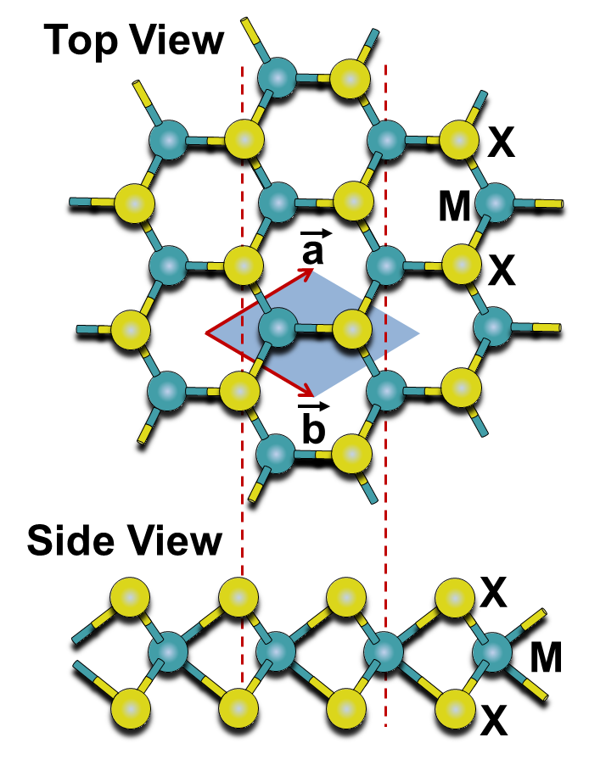
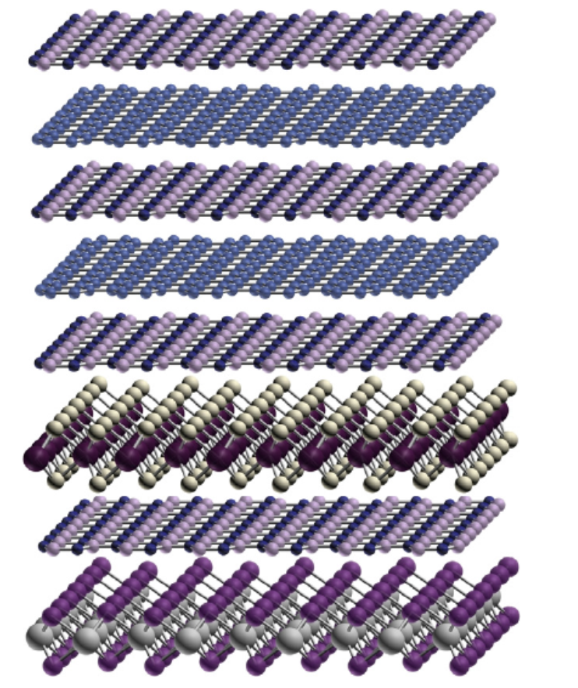
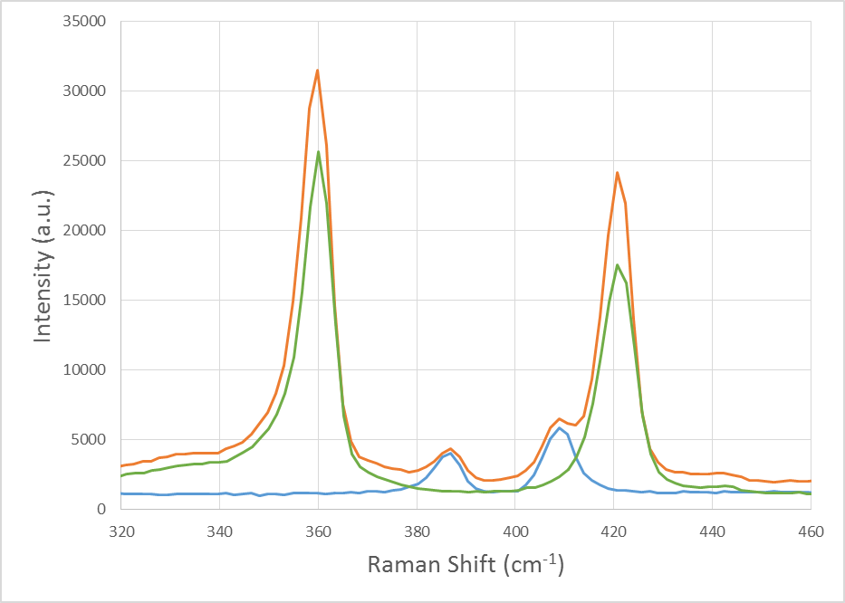
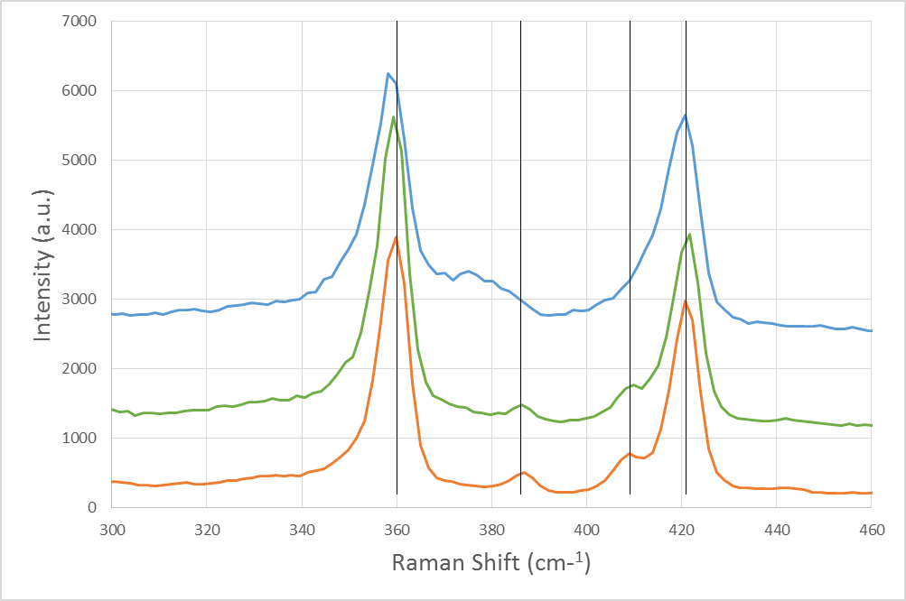
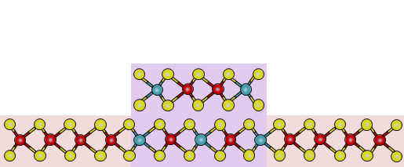
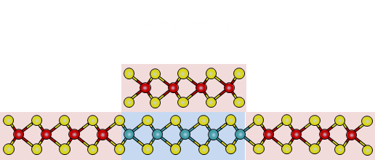
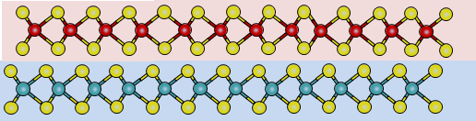
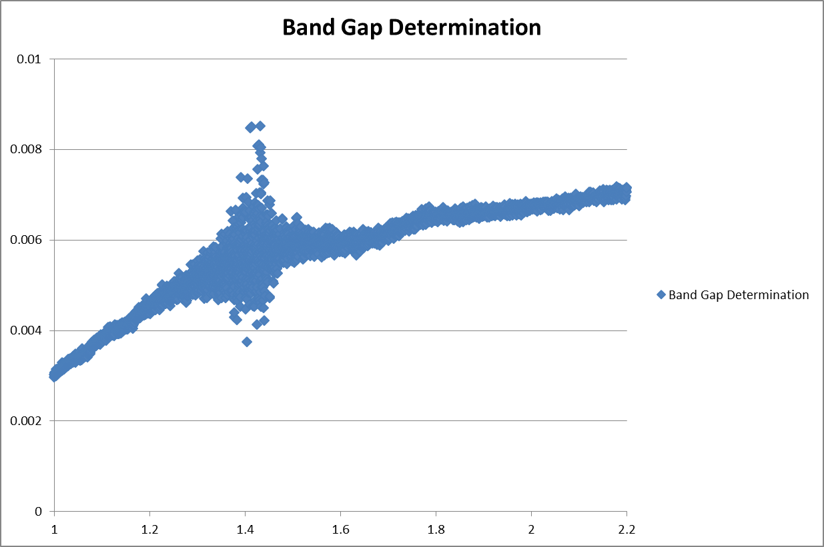
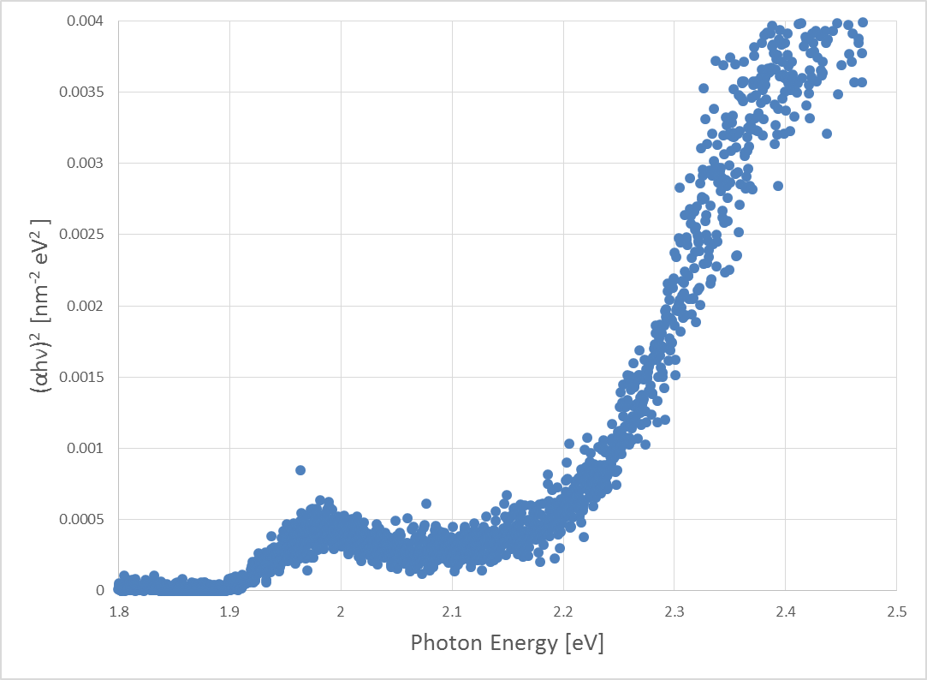
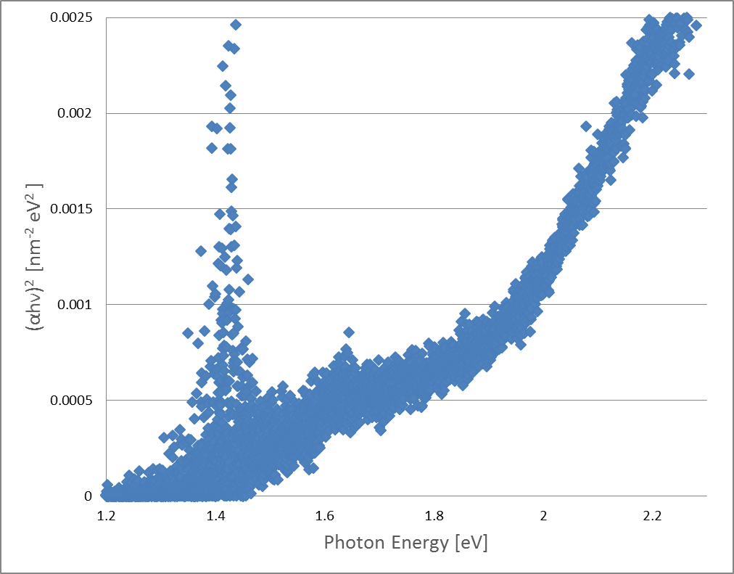
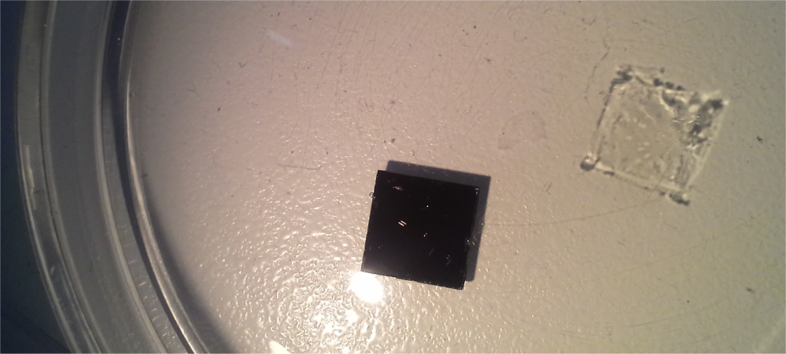
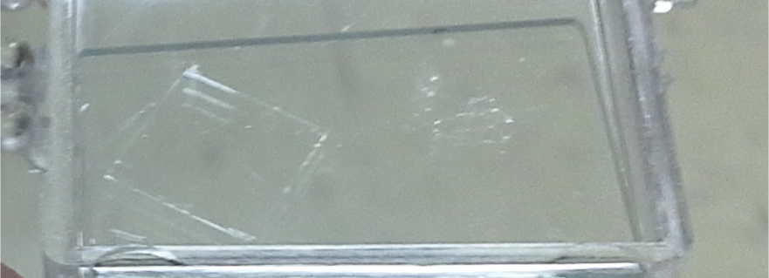
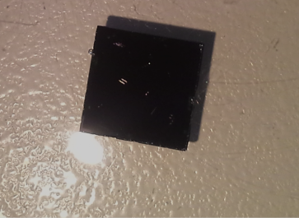
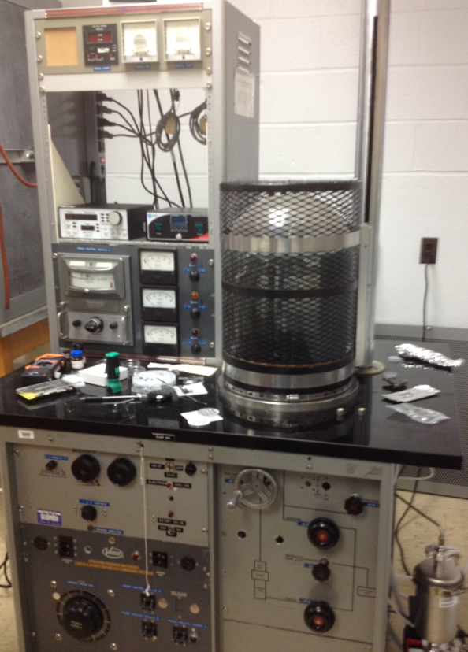
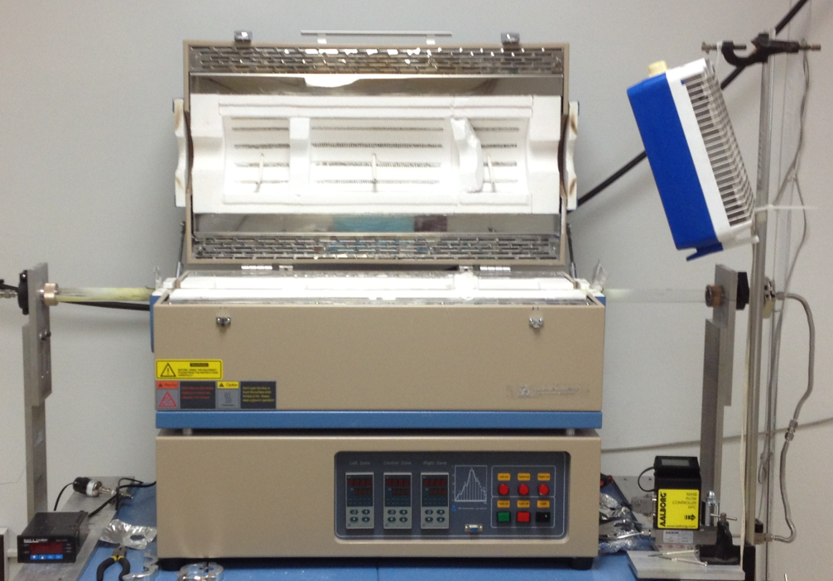

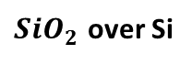
Semiconductor Heterostructures of Monolayer Transition Metal Dichalcogenides
JACOB S. TOWNSON¹, GEORGE ANDERSON², SREYANSH AGARWAL², and HUMBERTO GUTIERREZ²
Department of Math, Physics, and Computer Science, Georgetown College, Georgetown KY, 40324¹.
The Department of Physics and Astronomy, University of Louisville, Louisville KY, 40202².
Abstract: Transition metal dichalcogenides are a growing interest in the community of condensed matter physics. These substances show promise in the areas of small electronics, optoelectronic devices, and low powered devices. Our group observed the properties of single layered (2 dimensional) semiconductor heterostructures. To make our materials, we cleaned substrates, place them in a thermal evaporator to put on the transition metals, and then put on the chalcogen layer through chemical vapor deposition using a three zone furnace (chalcogenization). We made the heterostructure films in three different ways, known as Series A, B, and C. In Series A, we put both transition metals on the substrate through thermal evaporation, and then put the samples through chalcogenization. In Series B, we put one metal on the substrate and put it through chalcogenization, then repeated the process with another transition metal. For Series C we made two separate films, then put them through a film transfer to stack the films and make heterostructures. Our methods of observing the materials include Raman spectroscopy, UV visible optical spectroscopy, TEM, and AFM. Our results approximately lined up with the previously published theoretical. This shows promise for making the materials using the methods we used. We hope to make a device using our films to show their potential uses.
Background
Synthesis Continued
Discussion
Definitions:
Heterostructure- combination of multiple heterojunctions
Heterojunction- interface that occurs between 2 layers of dissimilar crystalline semiconductors
Band Gap- energy range in a solid where no electron state can exist, in between a valence band and conduction band
Chalcogenide- chemical compound consisting of at least one chalcogen (Sulfur, Selenium, Tellurium) anion and at least one more electropositive element (ex. MoS2)
Substrate - the surface or material on which a material grows (what we make our films on)
TMD – Transition Metal Dichalcogenide
Applications:
Can be used for things such as solar cells
Optoelectric Devices
Other Low-Power Electronics
There were 3 ways in which we made our films: Series A, B, and C. Below are diagrams of how each type of sample was made.
As mentioned before, I didn’t have much work in the data for AFM or TEM, so I don’t have any data to present on it. I also worked more with Series C than the other Series’, so my data and results focus more on these things.
When looking at the data from the Raman, we can compare Series C to Series A and B Raman data. When looking at the scan on the left, it’s easy to see that the WS2 and the MoS2 peaks line up perfectly with the Series C scan. The peaks are also distinct, which shows us that alloying is not a problem at all (in previous data Series A and B peaks would meld together to make one peak due to alloying). This is easier to see in the graph on the right, where the scans of Series A, B, and C are compared. Series C has the distinct peaks, whereas Series A and B peaks will form together to make a wider peak.
In the absorption scans, we see a consistent set of noise around 1.5 eV. This was due to a problem in our equipment that we used to collect the data. Unfortunately, we never were able to correct the problem before I left the lab. However, Using the Beer-Lambert Law and calculations using differential equations and formulas given to us by the Spectrometers software, we were able to begin calculating the direct band gap of all the materials made. In the graphs, it can be seen how we calculated the band gap. The thicknesses of our materials were also needed. We calculated this by using the atomic thickness of the atoms used to make the single layer, and the theoretical space between a single layer of a TMD. We would find the x intercept of the linear portion of the graph of the absorption vs. the energy. After calculating the band gaps from our experimental data, we compared our numbers to that of the theoretical values found by others. The values were approximately close, and showed good promise for the theoretical values, and our experimental values.
(1) MoO₃ Thermal Evaporation
(2) Mask removal
(2B) Chalcogenization
(1) TMD1, after thermal evaporation and Chalcogenization
(1) TMD2, after thermal evaporation and Chalcogenization
X = S, Se or Te
(3) WO₃ Thermal Evaporation
(2) Coat TMD1 with PMMA
Series A
W_{y}Mo_{1-y}X₂
(3) Detach PMMA/TMD1 from substrate using KOH
M= Transition Metal
X = Chalcogen
WX₂
W_{y}Mo_{1-y}X₂
WX₂
(4) Chalcogenization
(4) Retrieve PMMA/TMD1 with TMD2
8
O
Oxygen
Series B
WX₂
Series C
TMD1
(5) Remove PMMA with Acetone
42
Mo
Molybdenum
16
S
Sulfur
WX₂
MoX₂
WX₂
Heterostructure
Series A
Heterostructure
Series B
TMD2
Heterostructure
Series C
74
W
Tungsten
34
Se
Selenium
Analysis/Results
2D Stacked Crystal Heterostructure
52
Te
Tellurium
The results presented are the results that my focus was on, which are through Raman Spectroscopy and UV Visible Spectroscopy. Raman Spectroscopy can show us what materials are on our film, they number of layers we have on our film, and the effect of possible alloying on our films. UV visible spectroscopy can show us the transparency of our films, which can be used to find the percent transmission and the absorbance. After doing certain calculations, and using previous research, we were able to use this to find the band gap of our films. In order to measure this we had to put our films on a transparent substrate like glass, then account for the glass in our final measurements.
Inplane Heterostructure layout
WS2/MoS2 Series C Bilayer
MoS2 monolayer used in
Series C
WS2 monolayer used in
Series C
WS2/MoS2 Series A
WS2/MoS2 Series B
WS2/MoS2 Series C
E¹_{2g}
WS₂
E¹_{2g}
MoS₂
A_{1g}
MoS₂
A_{1g}
WS₂
Conclusions & Future Work
Overall, the conclusions that we can come to from our work are that Series C is much better than Series A and B when it comes to the problems of alloying. However, we still don’t know what the effects of alloying are other than from Raman and what it does to the band gap. In future studies, we hope to find more properties of these materials, as well as hopefully make a device using our films to show more specifically how they can be used. We also hope to go into more work with Tellurium as a chalcogen for our TMDs.
Synthesis
Series C
Substrate Cleaning
Our films are deposited on ${SiO}_{2}$ (See Fig. 1)
Before any depositing or growth, we clean substrates through a sonic bath with acetone then putting it in Piranha solution.
Thermal Evaporation
We put a transition metal oxide into a conductive boat. The material in the boat goes through sublimation. Using this method, we deposit a single layer of the Transition Metal’s Oxide to the substrate. (See Fig. 2)
Chemical Vapor Deposition
To go through this process we would use a three zone furnace to heat our samples and the chalcogen atoms.
Through CVD, we deposited the chalcogen atoms to the substrate with the tranistion metal, making a TMD. (See Fig. 3)
Spin Coating
Using our Spin Coater, we would spread a layer of PMMA over the substrate with the film on top. By doing this, we could then do a film transfer to put our film on a different substrate such as glass for Optical Absorption Testing.
KOH Assisted Film Transfer
Using KOH, we could remove the film with little to no damage to a different substrate. (See Fig. 4)
These graphs are of Raman data gathered. Using the comparison between Series A, B, and C, we can see the effects of alloying on both Series A and B (moreso in Series A), as with Series C we saw no alloying whatsoever.
Literature Cited
1.) Band gap determination using absorption spectrum fitting procedure
Author: Nader Ghobadi
2.) Optical Band Gap Studies of Tungsten Sulphoselenide Single Crystals Grown by a DVT Technique
Author: D.A. Dholakia, G.K. Solanki, S.G. Patel, and M.K. Agarwal
3.) Optical Properties of Thin Semiconductor Films
Author: Grolik Benno, Kopp Joachim
4.)CdTiO3 thin films from an octa-nuclear bimetallic single source precursor by aerosol assisted chemical vapo deposition
Author: Shahzad Abu Bakar, Syed Tajammul Hussain and Muhammad Mazhar
5.) Optoelectronics, by E. Rosencher, 2002, equation (7.25)-Wikipedia
6.)Optical Processes in Semiconductors, by Jacques I. Pankove, 1971
7.) Band offsets and heterostructures of two-dimenstional semiconductors
Author: Jun Kang, Sefaattin Tongay, Jian Zhou, Jingbo Li, and Junqiao Wu
8.) Novel hetero-layered materials with tunable direct band gaps by sandwiching different metal disulfides and diselenides
Author: Humberto Terrones, Florentino Lopez-Urias, and Mauricio Terrones
9.) First principles study of structural vibrational and electronic properties of graphene-like MX2 (M= Mo, Nb, W, Ta; X= S, Se, Te) monolayers
Author: Yi Ding, Yanli Wang, Jun Ni, Lin Shi, Siqi Shi, Weihua Tang
10.) Electronegativity and Bond Energy
Author: R. T. Sanderson
Left: This is a scan of just the glass. Due to a problem with our equipment, we got a lot of noise around 1.5 eV
Middle: Scan of WS2 by itself, absorbance vs. energy
Right: WSe2 over MoSe2 Series B absorbance vs. energy
Below: Table of calculated band gaps. Found by finding the x intercept of the linear portion of the graph.
(a)
Sample | Direct E_{g} Experiment | Indirect E_{g} Experiment | Eg Ref. 8 | Eg. Ref. 8 A Stacking | Eg. Ref. 8 B Stacking
WS2 monolayer | 2.199 eV |  | 1.940 eV
MoS2 monolayer | 1.829 eV |  | 1.823 eV
WSe2 monolayer | 1.722 eV |  | 1.676 eV
MoSe2 monolayer | 1.655 eV |  | 1.606 eV
WS2/MoS2 Series A | 1.990 eV | 1.573 eV |  | 1.695 eV | 1.708 eV
WS2/MoS2 Series B | 2.144 eV | 1.672 eV |  | 1.695 eV | 1.708 eV
WS2/MoS2 Series C | 1.489 eV | .795 eV
WSe2/MoSe2 SeriesA | 1.806eV | 1.124 eV |  | 1.443 eV | 1.471 eV
WSe2/MoSe2 Series B | Ongoing | Ongoing |  | 1.443 eV | 1.471 eV
WSe2/MoSe2 SeriesC | 1.86 eV | .759 eV
(b)
TMD film
transferred to
a glass substrate
${SiO}_{2}$ over Si
N₂ or Ar+H
Chemical Vapor Deposition
Figure 4
Chalcogen
MoO₃ or WO₃
Figure 1
Three separate temperature controlled zones
MoO₃ or WO₃
Figure 3
Figure 2
Boat heated up to high temperatures

